Slide 1
POSIT Team - FPGA
Melika Morsali
Hasantha Ekanayake

Slide 2
MOTIVATION
Modern deep learning models are memory- and compute-intensive.
Weight-only quantization reduces memory footprint without sacrificing accuracy.
Posit arithmetic offers a better tradeoff than IEEE floats: → Higher precision + dynamic range at lower bit-widths.
We designed a custom IP core that performs FP16-Posit4 multiplication, enabling:
Memory efficiency with compact 4-bit Posit weights
FP16 compatibility for ease of integration
Efficient computation with reduced logic
Our architecture uses less hardware than FP16-Int4 unit.
Notes:
One effective solution is weight-only quantization, which reduces memory load while maintaining accuracy.
At the meanwhile Posit arithmetic offering higher precision and dynamic range at very low bit-widths.
So in ou project we introduce a custom IP core that performs FP16 × Posit4 multiplication,

Slide 3
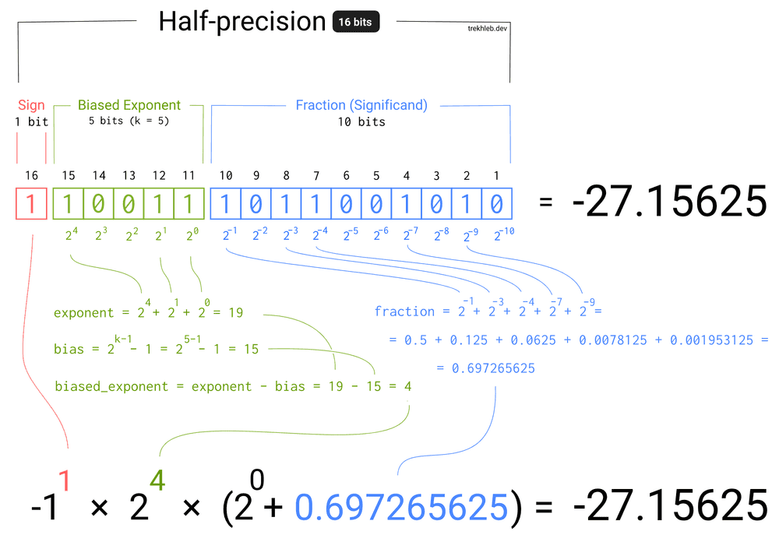
fp16

Slide 4
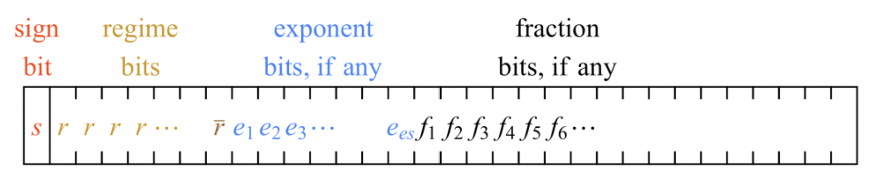
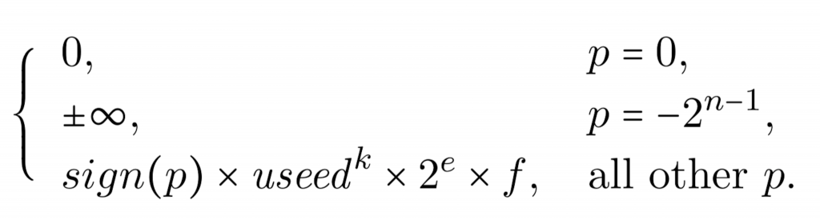
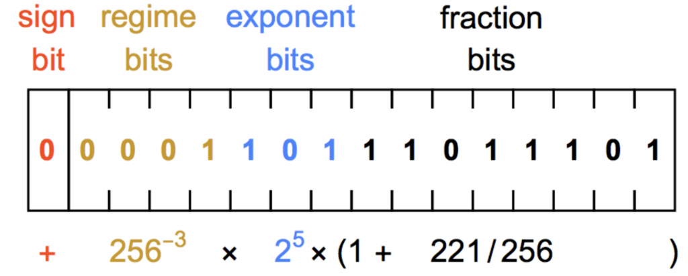

POSIT
Notes:
Posit numbers are similar to that but they have another part regime bits and it is a new way to represent real numbers using a compact format.
Each Posit is made up of:
A sign bit
A regime field that encodes scale in powers of the “useed”
An optional exponent bits
An optional fraction bits
The regime is encoded using a run of bits and its length determines the value of k, the regime exponent.
Here we have Decimal values of regime bits.
If the first bit is zero, the number of zeros (m) represents a negative value (-m). If it is one , the number of ones minus one (m-1) represents a positive value (m-1). And we are done with regime parts when we see r bar.
The regime bits determines a scale factor of useed^{k}, where useed = 2^{2es}. and es is the number of exponent bits.
The value of a posit is: ?

Slide 5
POSIT(bits,Es)
Posit(4,0) | Value
0000 | 0
0001 | 0.125
0010 | 0.25
0011 | 0.5
0100 | 1.0
0101 | 1.5
0110 | 3.0
0111 | 6.0
1000 | NaR
1001 | -6.0
1010 | -3.0
1011 | -1.5
1100 | -1.0
1101 | -0.5
1110 | -0.25
1111 | -0.125
Notes:
In our project we always consider es=0 so we have more for fractions and regime.
So used is always 2 and the regime exponent is 2^k which makes the multiplication easier.
Specifically, we consider 4 bit posit but our code can adjust the precision between 1 to 15 bits.
So with posit(4,0) we can have these range of values.

Slide 6
FP16-POSIT4 Mul
Stage | What Happens | Notes
1. Sign | sign_out = act_sign ⊕ weight_sign | XOR gives sign of product
2. Decode Posit | Stream the 4-bit weight • first bit = sign • run-length of next identical bits → regime k • remaining bits = posit mantissa | Posit value = 2^k × (1 + mant_frac)
3. Form Exponent | exp_out = fp16_exp + k (adjusted later by shifts) | Adds posit scale (2^k) to FP16 exponent
4. Shift&Add Mantissas | For every posit mantissa bit == 1→ left-shift FP16 mantissa and add to running 14-bit sum (mantissa_reg) | Same as binary long-multiplication: 1.m_FP16 × (1.xx…)_posit left shifts and additions
5. Done Pulse | After 4 cycles (one per posit bit) done goes high → outputs are valid | Latency = selected precision (4 for Posit4)
Notes:
Inputs / Outputs
act[15:0] = IEEE-754 FP16 activation (1 sign | 5 exp | 10 mantissa)
w[3:0] = Posit(4,0) weight (MSB first)
Handshake: valid, set, precision, done pulse
Outputs: sign_out, exp_out[4:0], mantissa_out[13:0], zero_out, NaR_out
Precision & Bit-Scanner
Latches a user-selected precision (1–8 bits) when set=1
A cycle counter (count) walks through each weight bit while valid=1
Three-State FSM
SIGN (first cycle) • Derives product sign (act_sign ⊕ w[MSB]) • Seeds exponent with FP16 exponent field • Detects Zero / NaR markers
REGIME (next cycles, until bit flip) • Counts identical bits to compute posit regime k • Adjusts exponent (exp_out += ±k) • Captures FP16 mantissa into a work register
MANTISSA (remaining cycles) • For every weight bit = 1: – Left-shifts FP16 mantissa (align) – Optionally decrements exponent for hidden-one handling • For weight bit = 0: exponent unchanged, mantissa contributes 0
Mantissa Pipeline & Accumulation
Two 14-bit registers (mantissa_reg, mantissa_temp) hold partial sums
A fixed-point adder (module fixed_point_adder) adds the freshly-shifted mantissa fragment (shifted_fp) into the running total every cycle
Final mantissa_out is presented together with the done pulse
Special Value Handling
Asserts zero_out or NaR_out on the same cycle as done if the decoded weight was 0 or NaR
Clears all flags on reset (rst=0)
Timing Summary
Latency = precision cycles (4 cycles for Posit 4,0)
Fully synchronous to clk, single-issue pipeline; can be re-triggered once done de-asserts

Slide 7
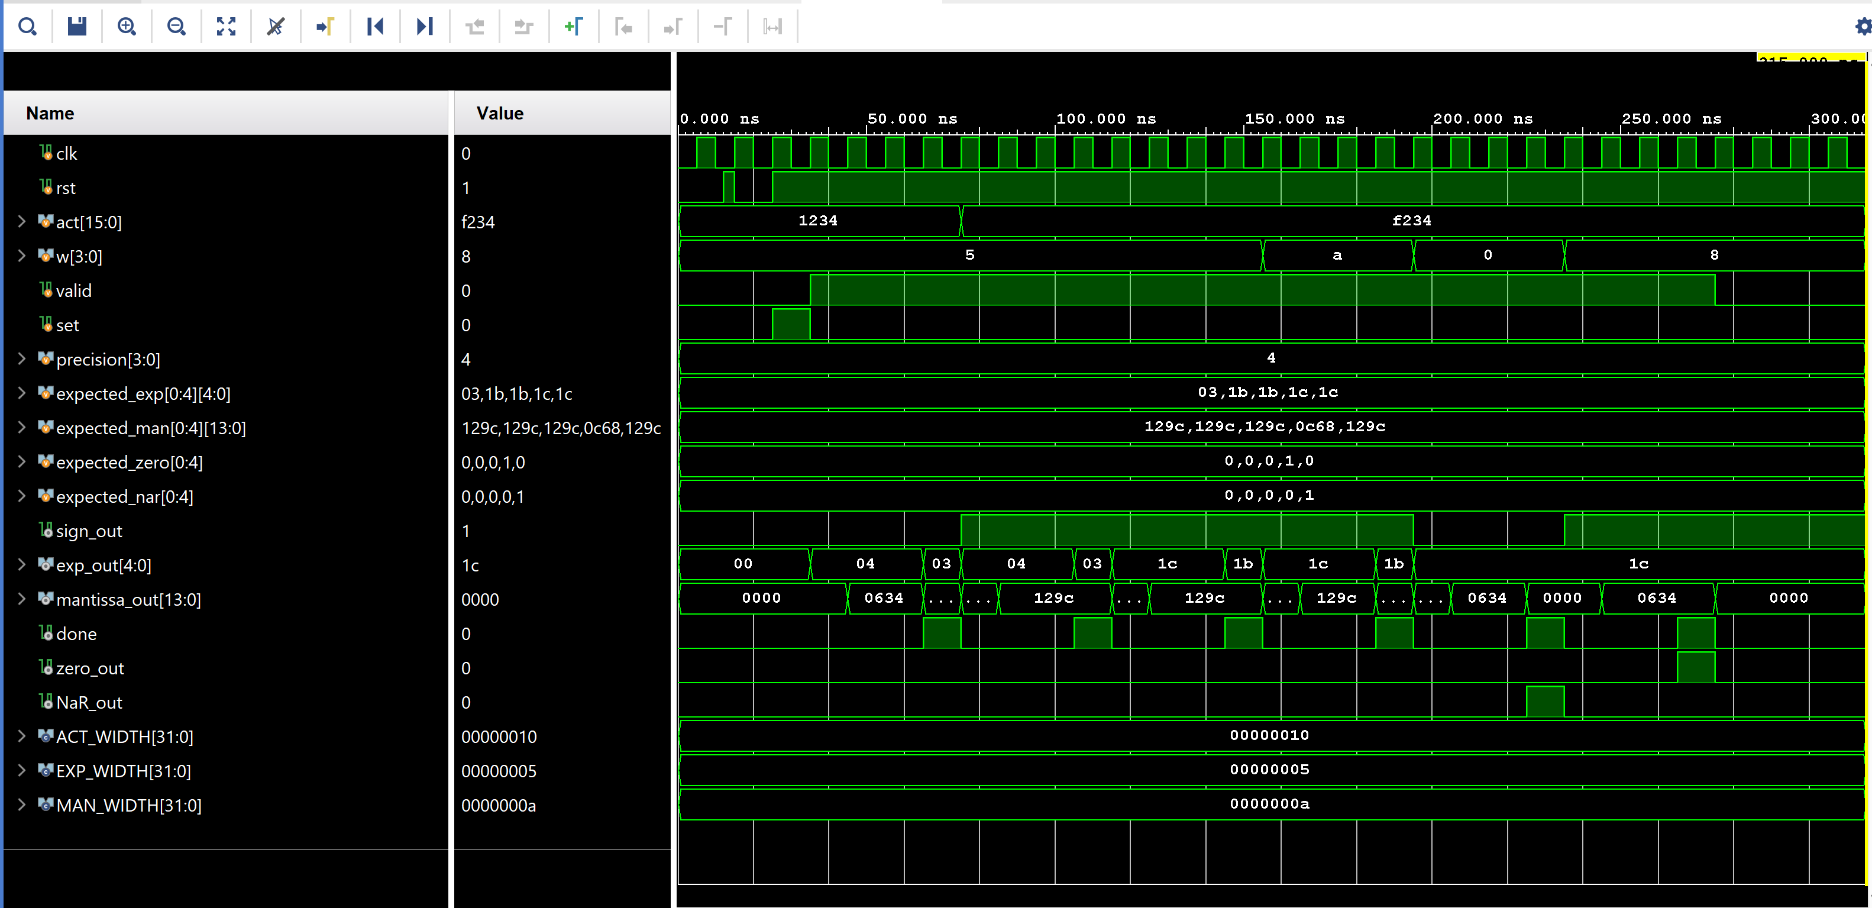
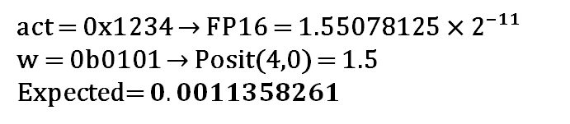
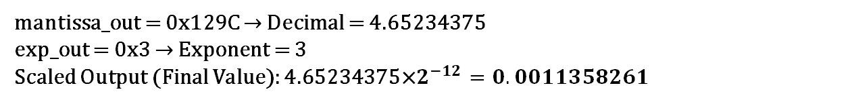
FP16-POSIT4 Mul Test Bench
act = 0x1234 → FP16 = 1.55078125 × 2⁻¹¹ w = 0b0101 → Posit(4,0) = 1.5
Expected= $0.0011358261$
mantissa_out = 0x129C → Decimal = 4.65234375 exp_out = 0x3 → Exponent = 3
Scaled Output (Final Value): 4.65234375×$2^{−12}=0.0011358261$
​
Notes:
Mantissa out is a signed 14-bit fixed-point number (4-bit before decimal point + 10-bit after the decimal point)

Slide 8
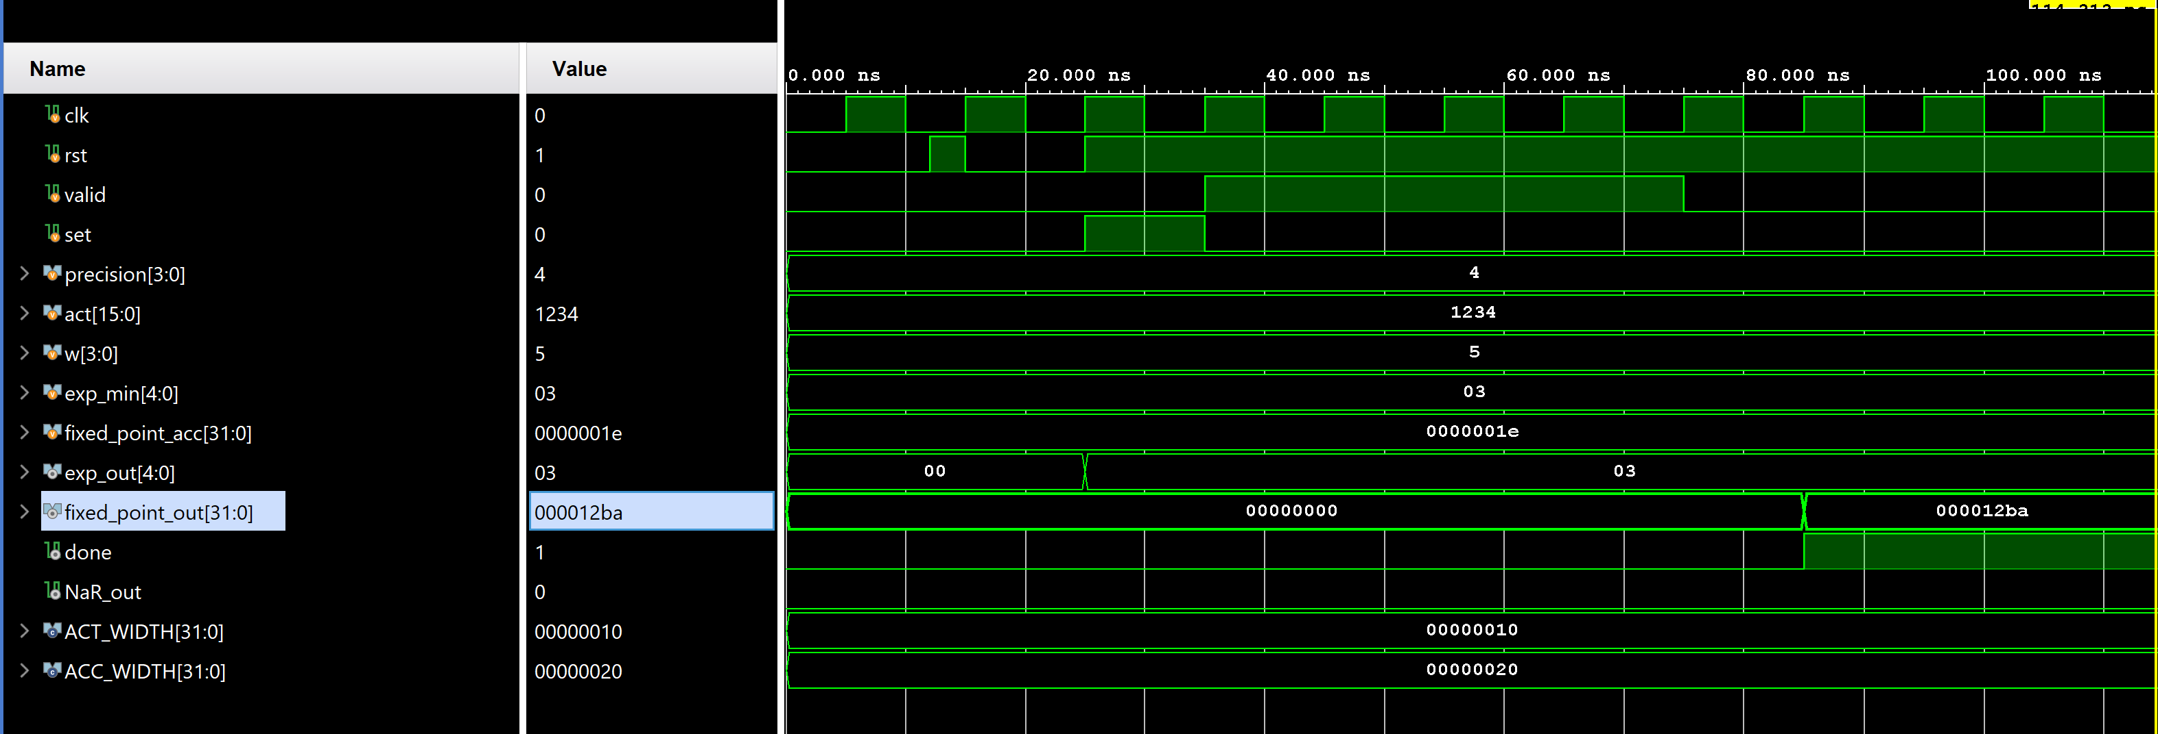
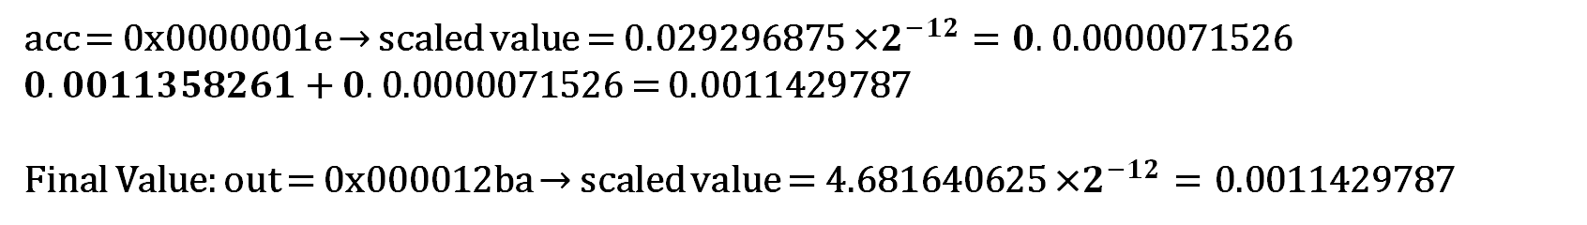
FP16-Posit4 MAC Test Bench
acc = 0x0000001e → scaled value = 0.029296875 ×$2^{−12}=0.\text{0.0000071526}$ $0.0011358261$ + $0.\text{0.0000071526}$ = 0.0011429787
Final Value: out = 0x000012ba → scaled value = 4.681640625 ×$2^{−12}=\text{0.0011429787}$
​
Notes:
We implement our mul with acc to perform mac operation.
Acc is a 32-bit fixed-point(22-bit.10-bit) output times 2 to the power of the biased exponent

Slide 9
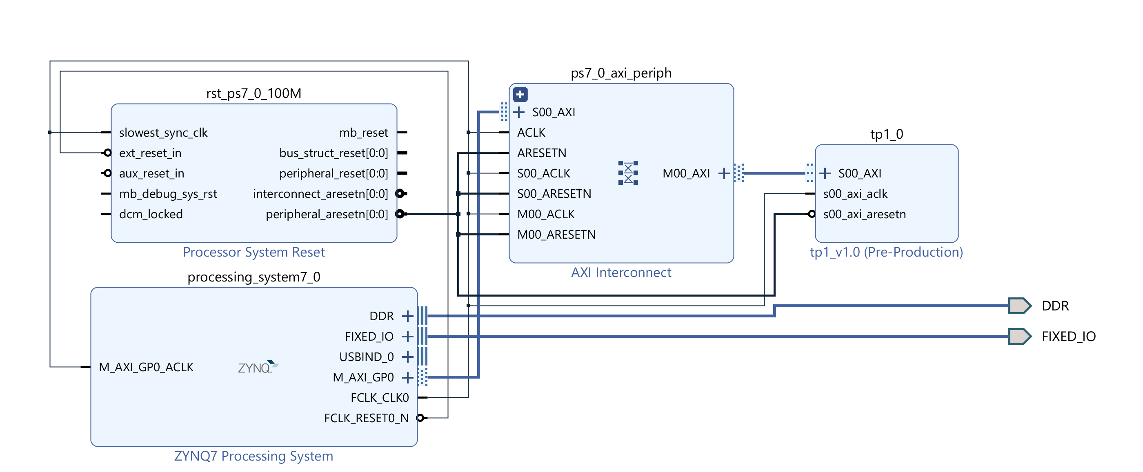
Creating A Custom IP for FP16-POSIT4 Mul
With AXI Lite
Write on Register 0 and Read from Register 1
​

Slide 10
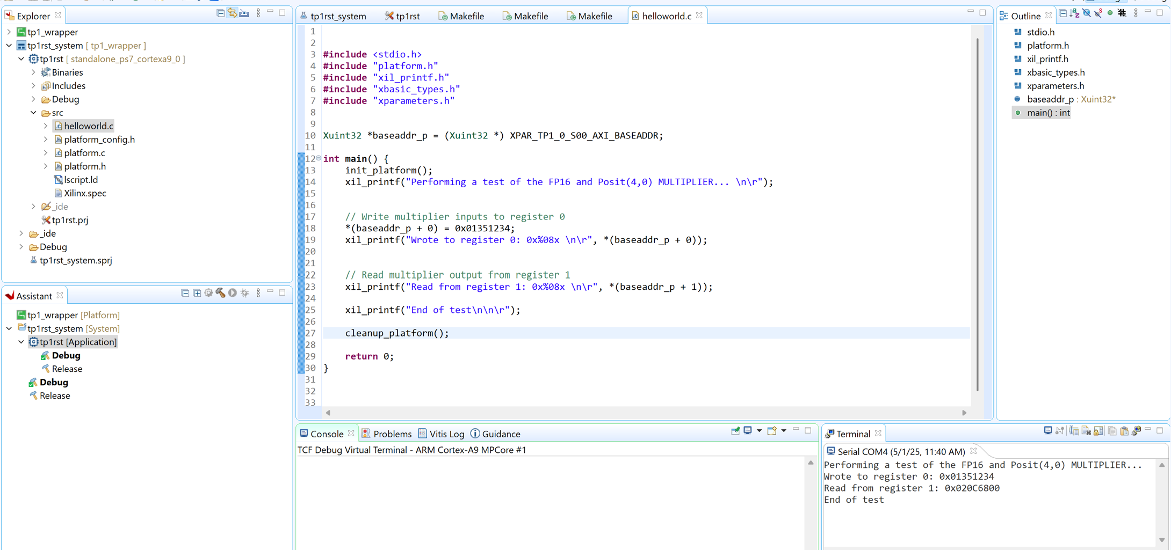
Demo of the FP16-POSIT4 Mul Custom IP
​
Write 0x01351234 on Register 0
Read 0x020C6800 from Register 1

Slide 11
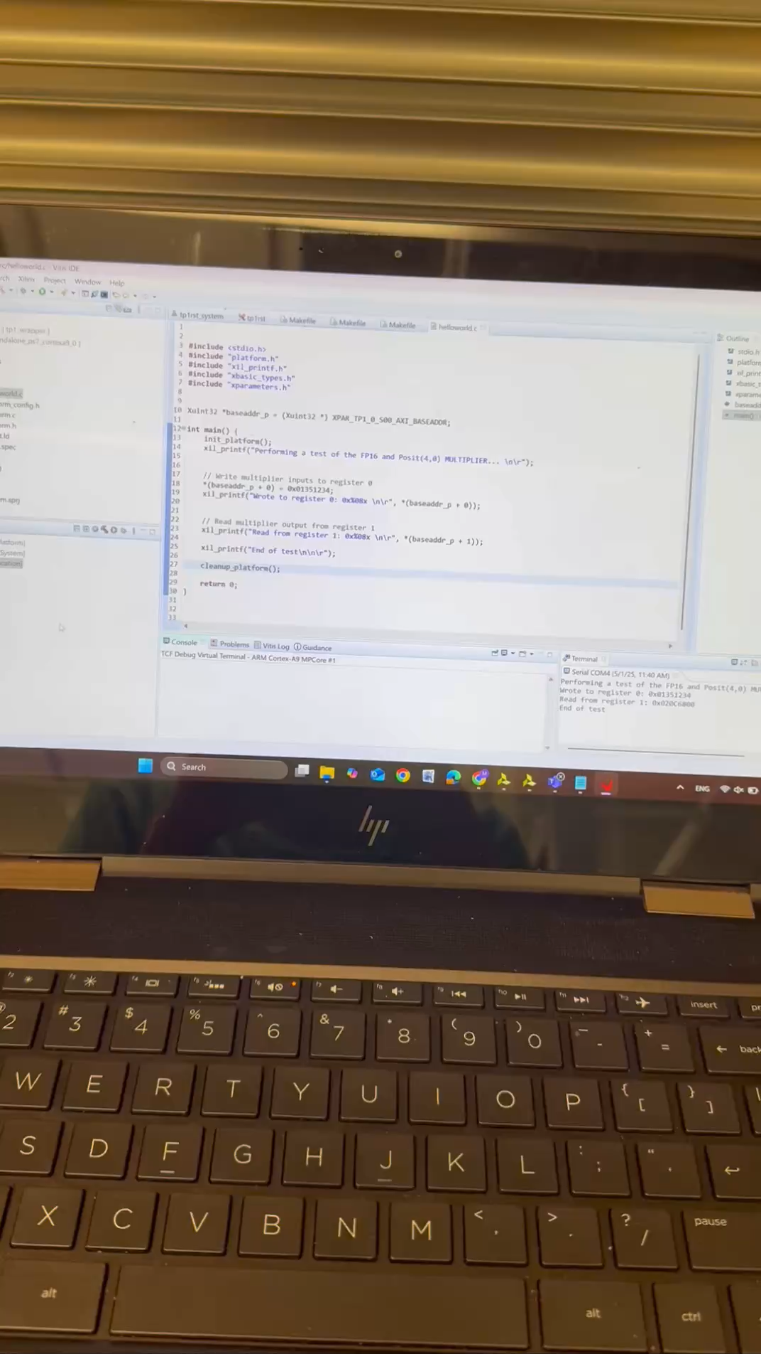
Demo of the FP16-POSIT4 Mul Custom IP
​

Slide 12
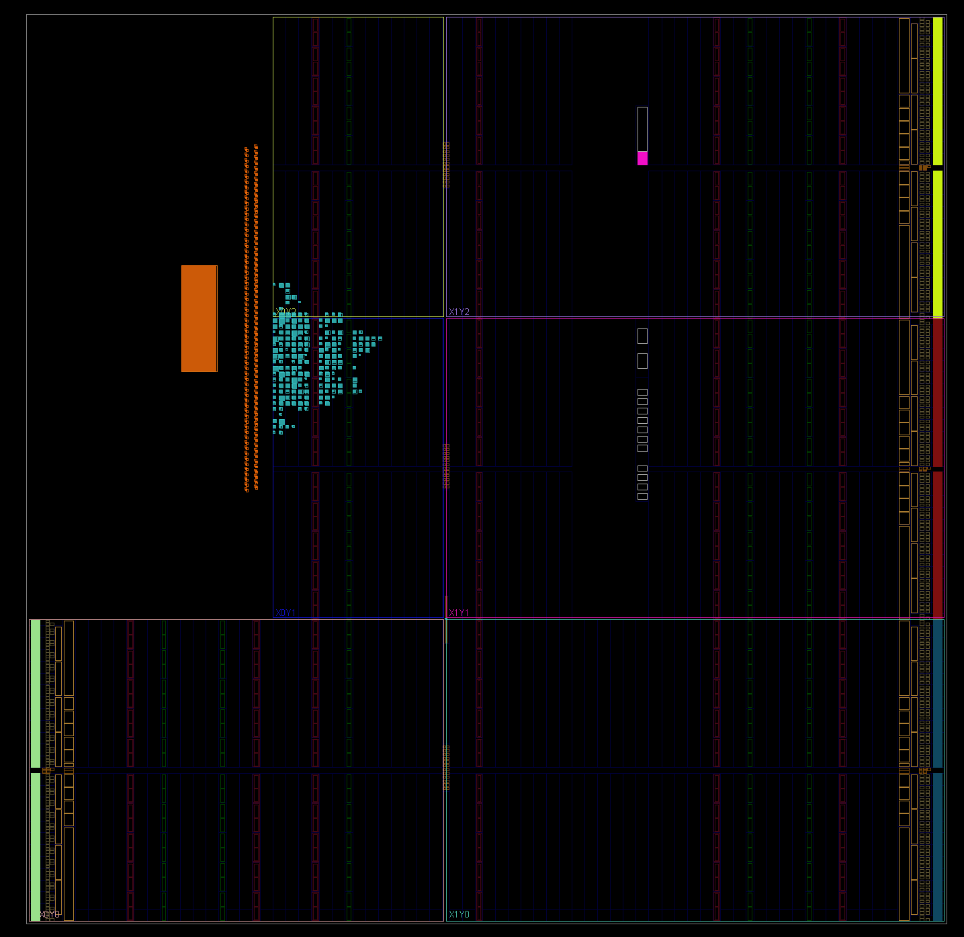
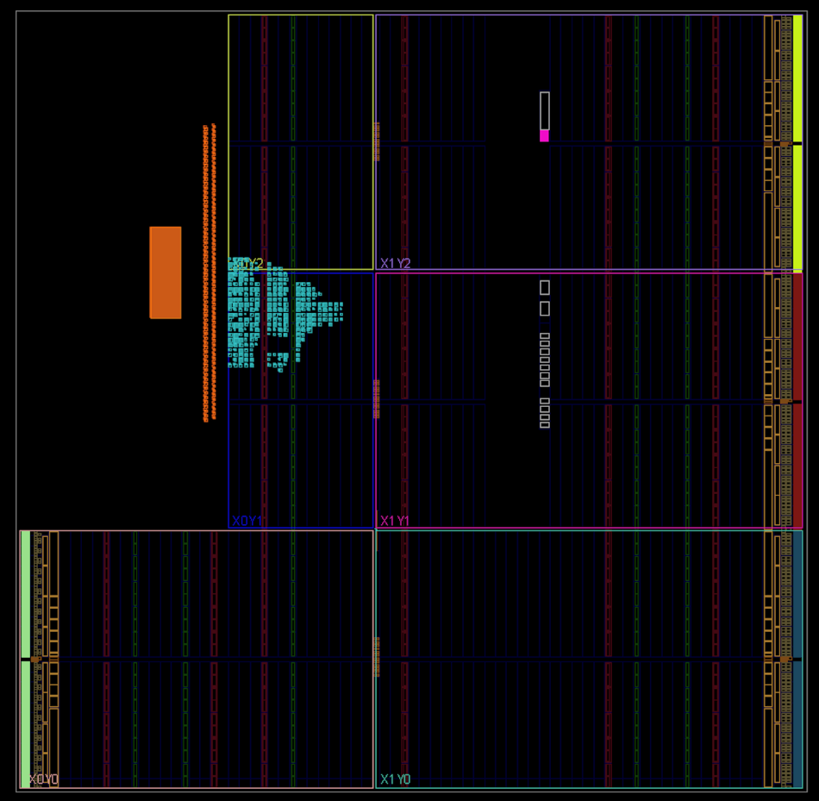
Comparing With FP16-int4 MAC
Resource Utilization of FP16-Posit4 MAC
Resource Utilization of FP16-Int4 MAC
​
LUT | FF
460 | 695
LUT | FF
658 | 792

Slide 13
POSIT Team - ASIC
Melika Morsali
Hasantha Ekanayake

Slide 14
MOTIVATION
Posit - Index-based Computation of Real Number Multiplication with SiliconCompiler
SiliconCompiler is an open source, modular, build system that automates translation from hardware design source code to silicon
Extend Moore’s Law Silicon has driven progress for 50 years; sustaining that requires ever-greater hardware specialization.
Design Bottleneck Custom chips promise huge gains but today’s toolchains demand too much manual effort.
Need for Automation Fully end-to-end compilers—orders of magnitude faster—are essential to serve the “long tail” of specialized applications.
Scale Beyond One Machine Single‐company, single‐machine solutions won’t suffice; we must build distributed compiler infrastructures that scale to thousands of developers and millions of servers.

Slide 15
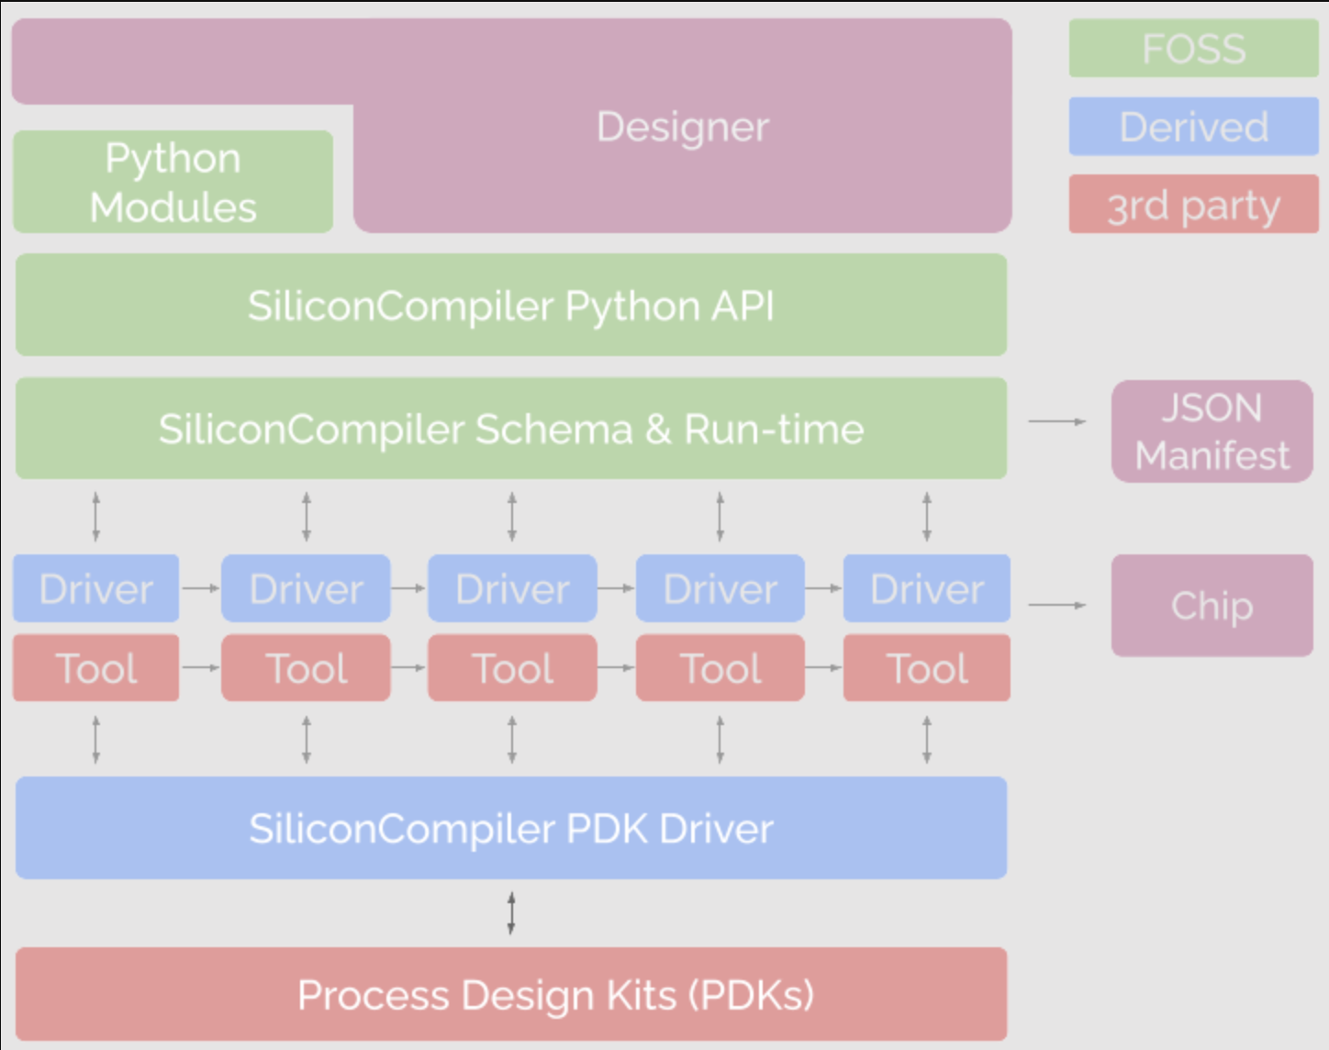
Approach
Standardized Schema A single, extensible data model that cleanly separates design descriptions, EDA tools, and Process Design Kits (PDKs), making complex flows configurable yet easy to grasp.
Python API & Flowgraph An object-oriented Python layer exposes simple set/get access to the schema, a parallel “flowgraph” programming model, and utility functions for setting up runs and collecting metrics.
Pluggable Drivers Tool- and PDK-specific drivers plug into the core schema at runtime, automatically discovered via a dynamic module search
Scalable & Extendable The combination of a rich schema, well-defined plugin interfaces, and comprehensive reference docs lets teams rapidly onboard new tools and PDKs without rewriting core code.
https://www.siliconcompiler.com/

Slide 16
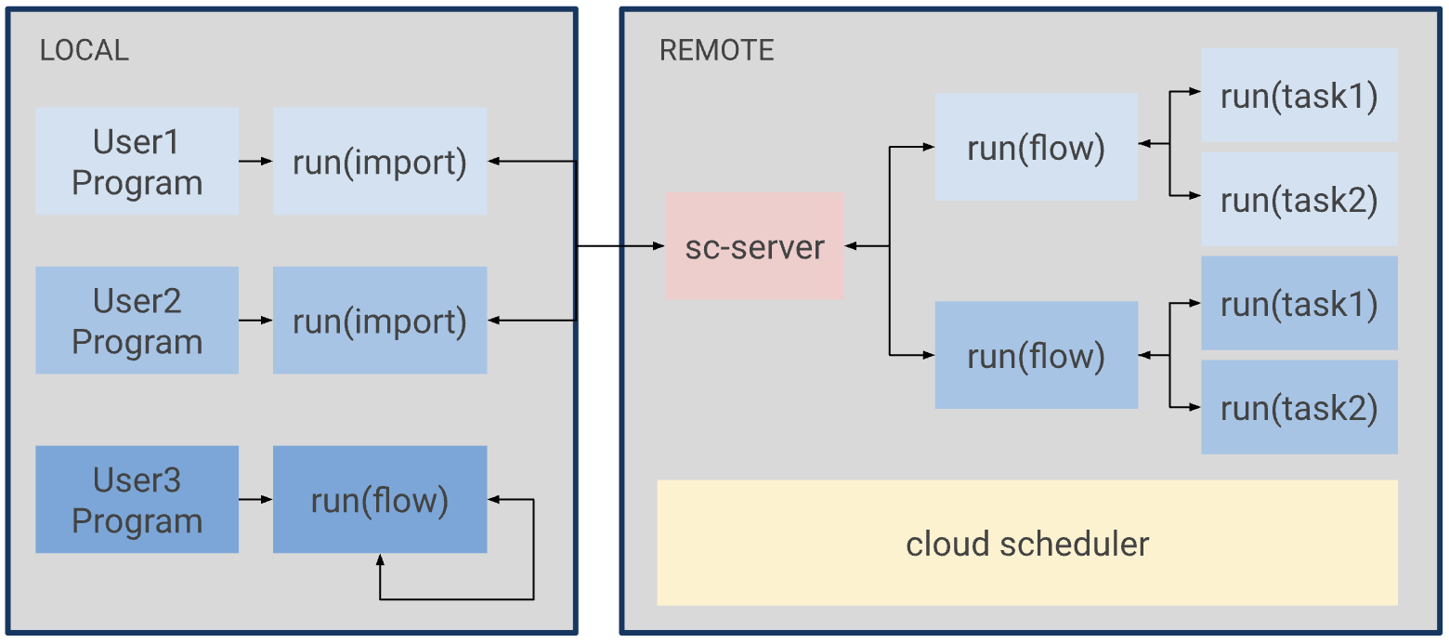
Supported Technologies
Client-Server Execution
1) reduce tool installation barriers
2) reduce the barrier to massively parallel elastic compute
3) address the NDA barrier for PDK and EDA tools.
Type | Supported
Languages | C, Verilog, SV, VHDL, Chisel, Migen/Amaranth, Bluespec, MLIR
Simulation | Verilator, Icarus, GHDL, Xyce
Synthesis | Yosys, Vivado, Synopsys, Cadence
ASIC APR | OpenROAD, Synopsys, Cadence
FPGA APR | VPR, nextpnr, Vivado
Layout Viewer | Klayout, OpenROAD, Cadence, Synopsys
DRC/LVS | Klayout, Magic, Synopsys, Siemens
PDKs | sky130, ihp130, gf180, asap7, freepdk45, gf12lp, gf22fdx, intel16
https://www.siliconcompiler.com/

Slide 17
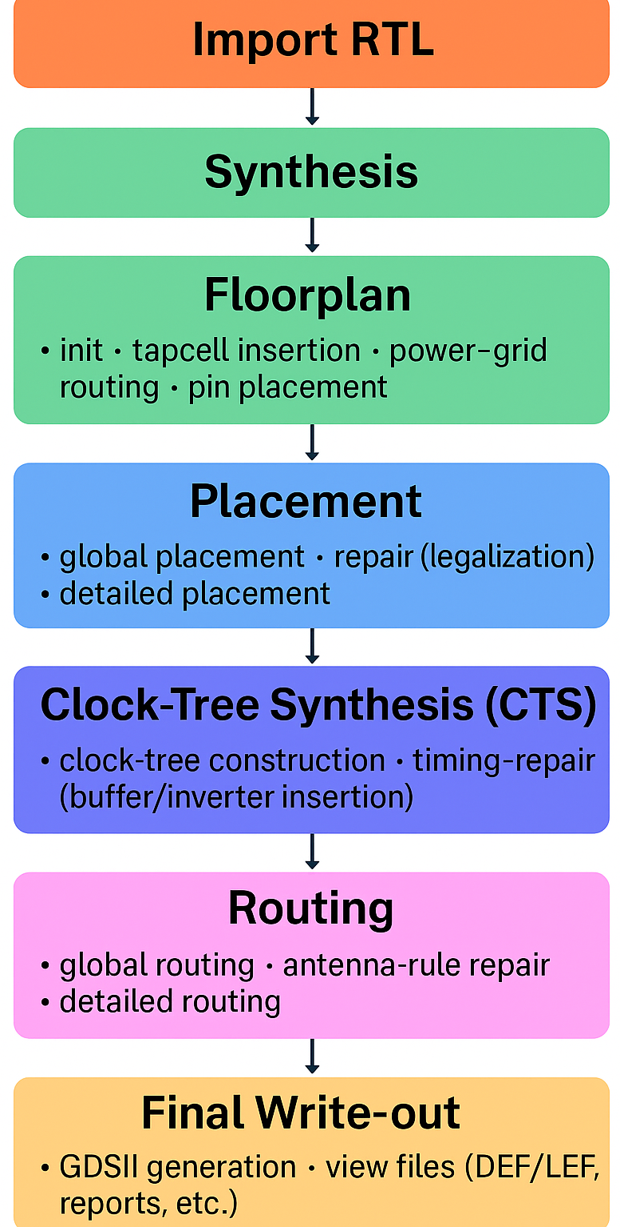
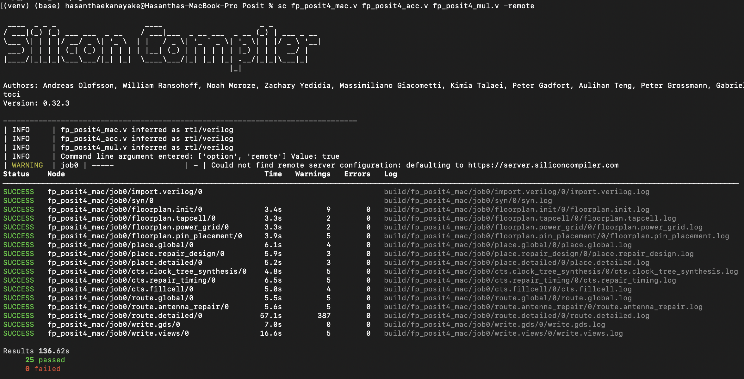
Design Flow

Slide 18
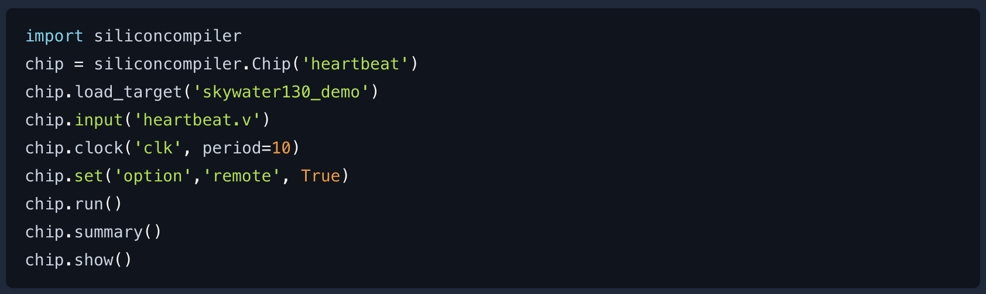
FP16-POSIT4 MAC
Import RTL
For the designs that are too complex to be compiled in command line

Slide 19
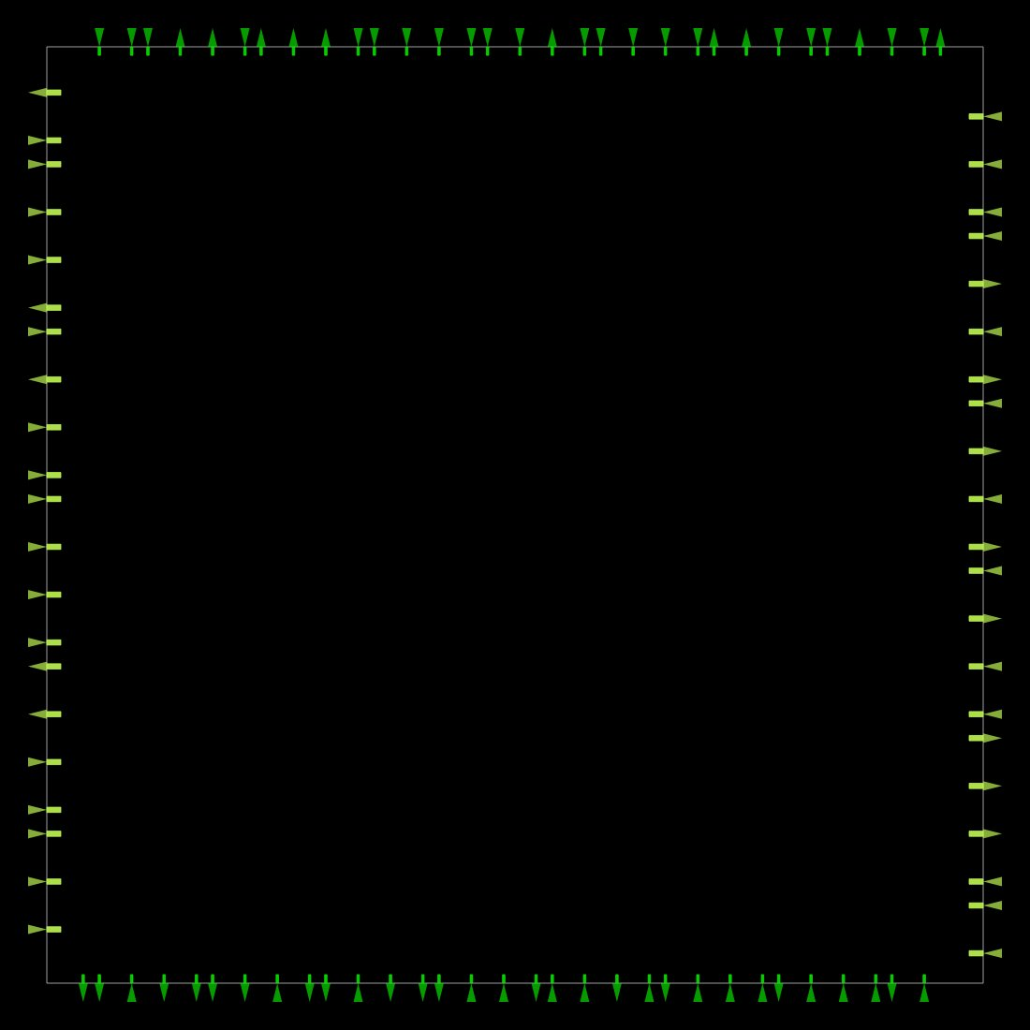
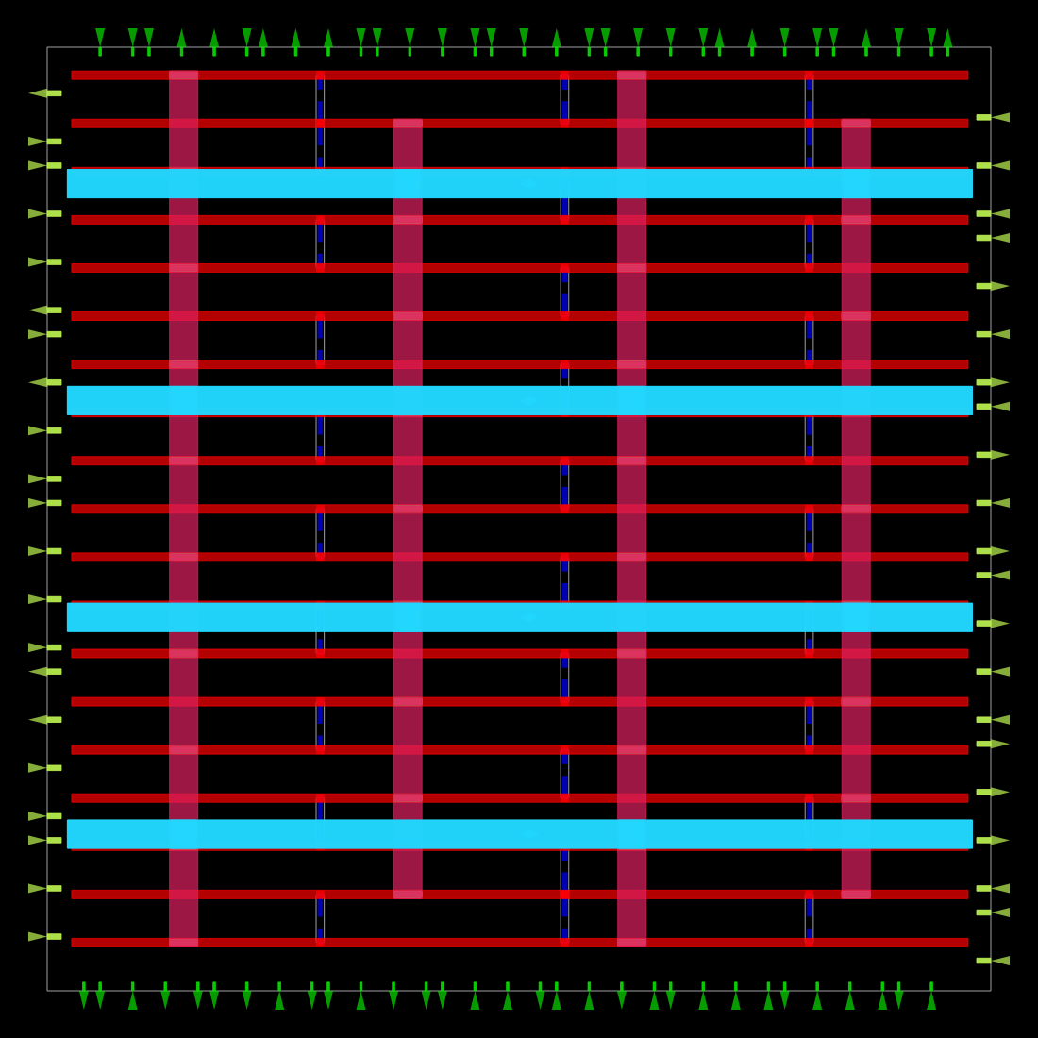
FP16-POSIT4 MAC
Floor Plan
Power and Ground Planning

Slide 20
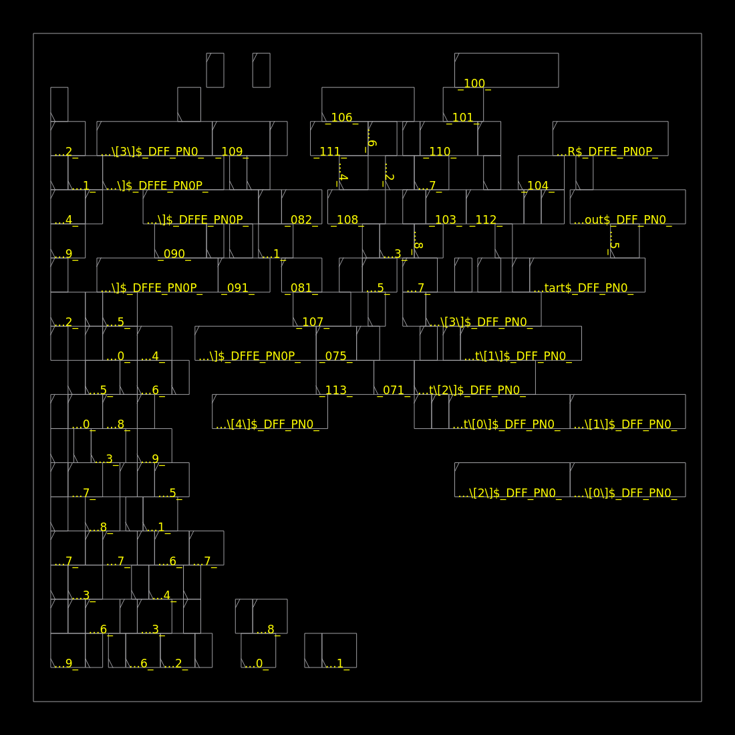
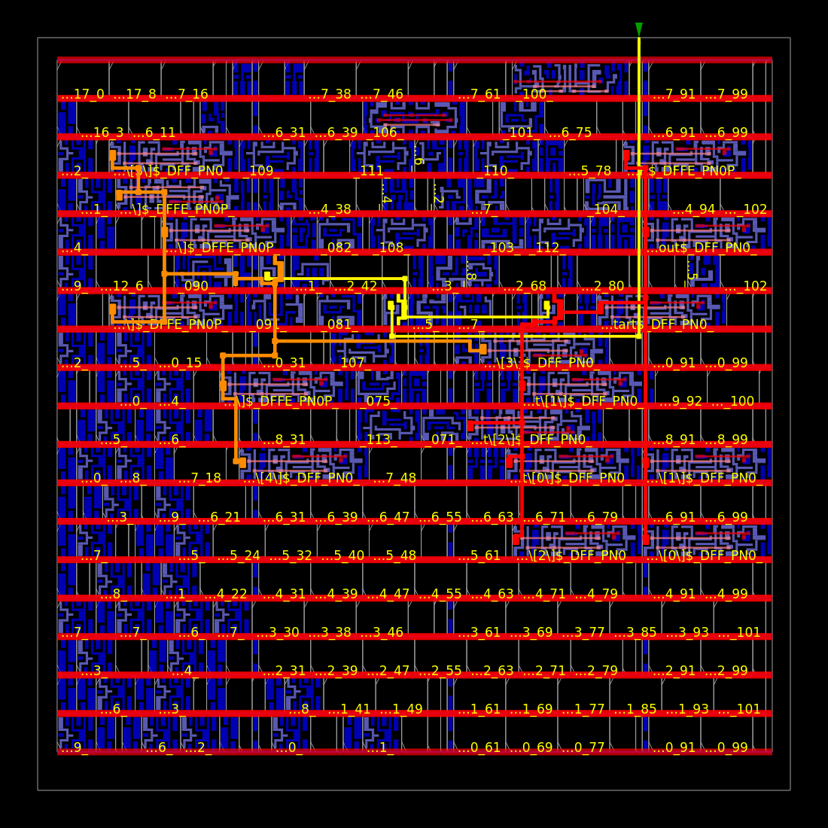
FP16-POSIT4 MAC
Placement
Clock

Slide 21
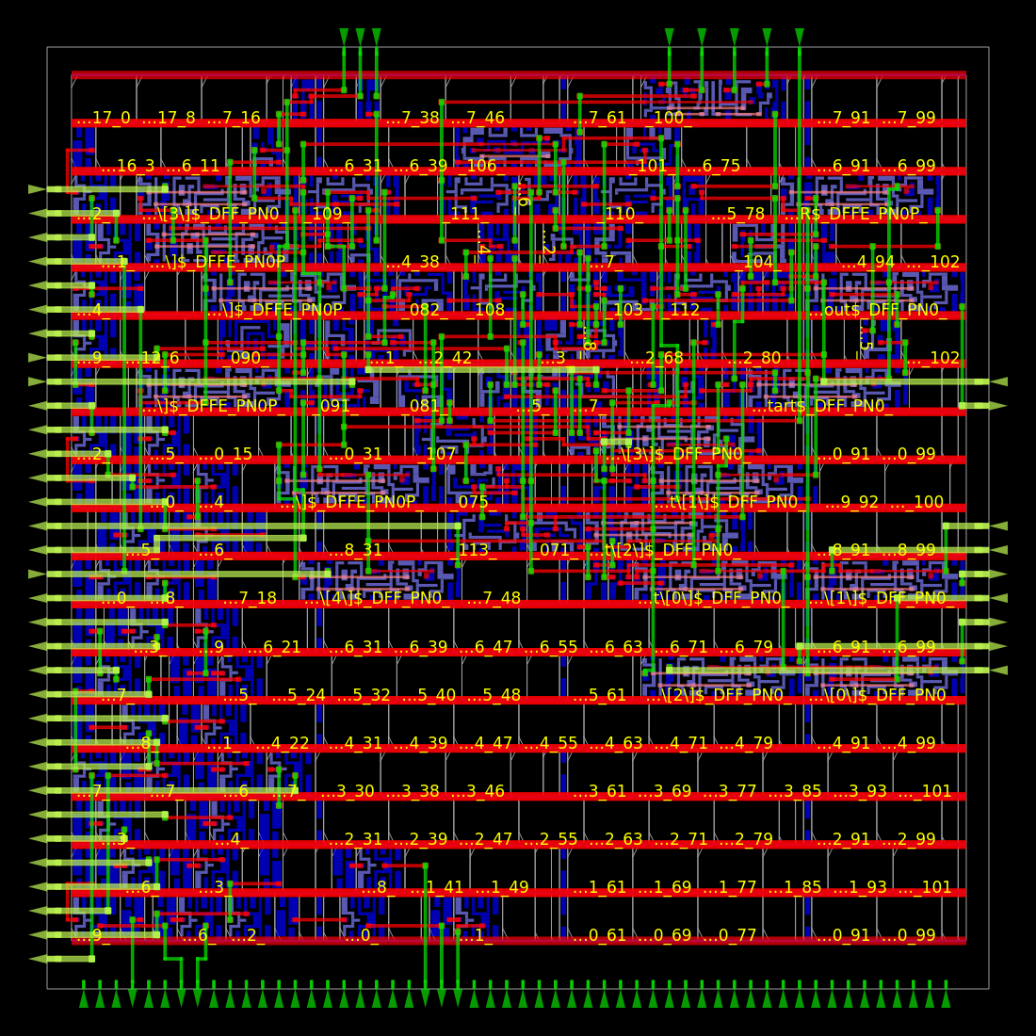
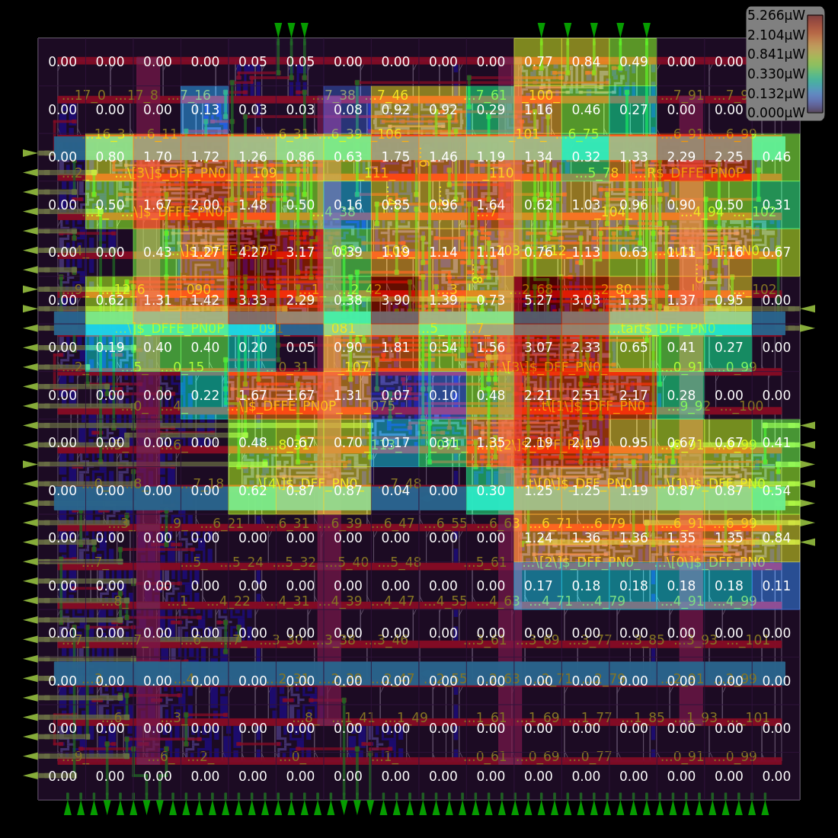
FP16-POSIT4 MAC
Routing
Power Density

Slide 22
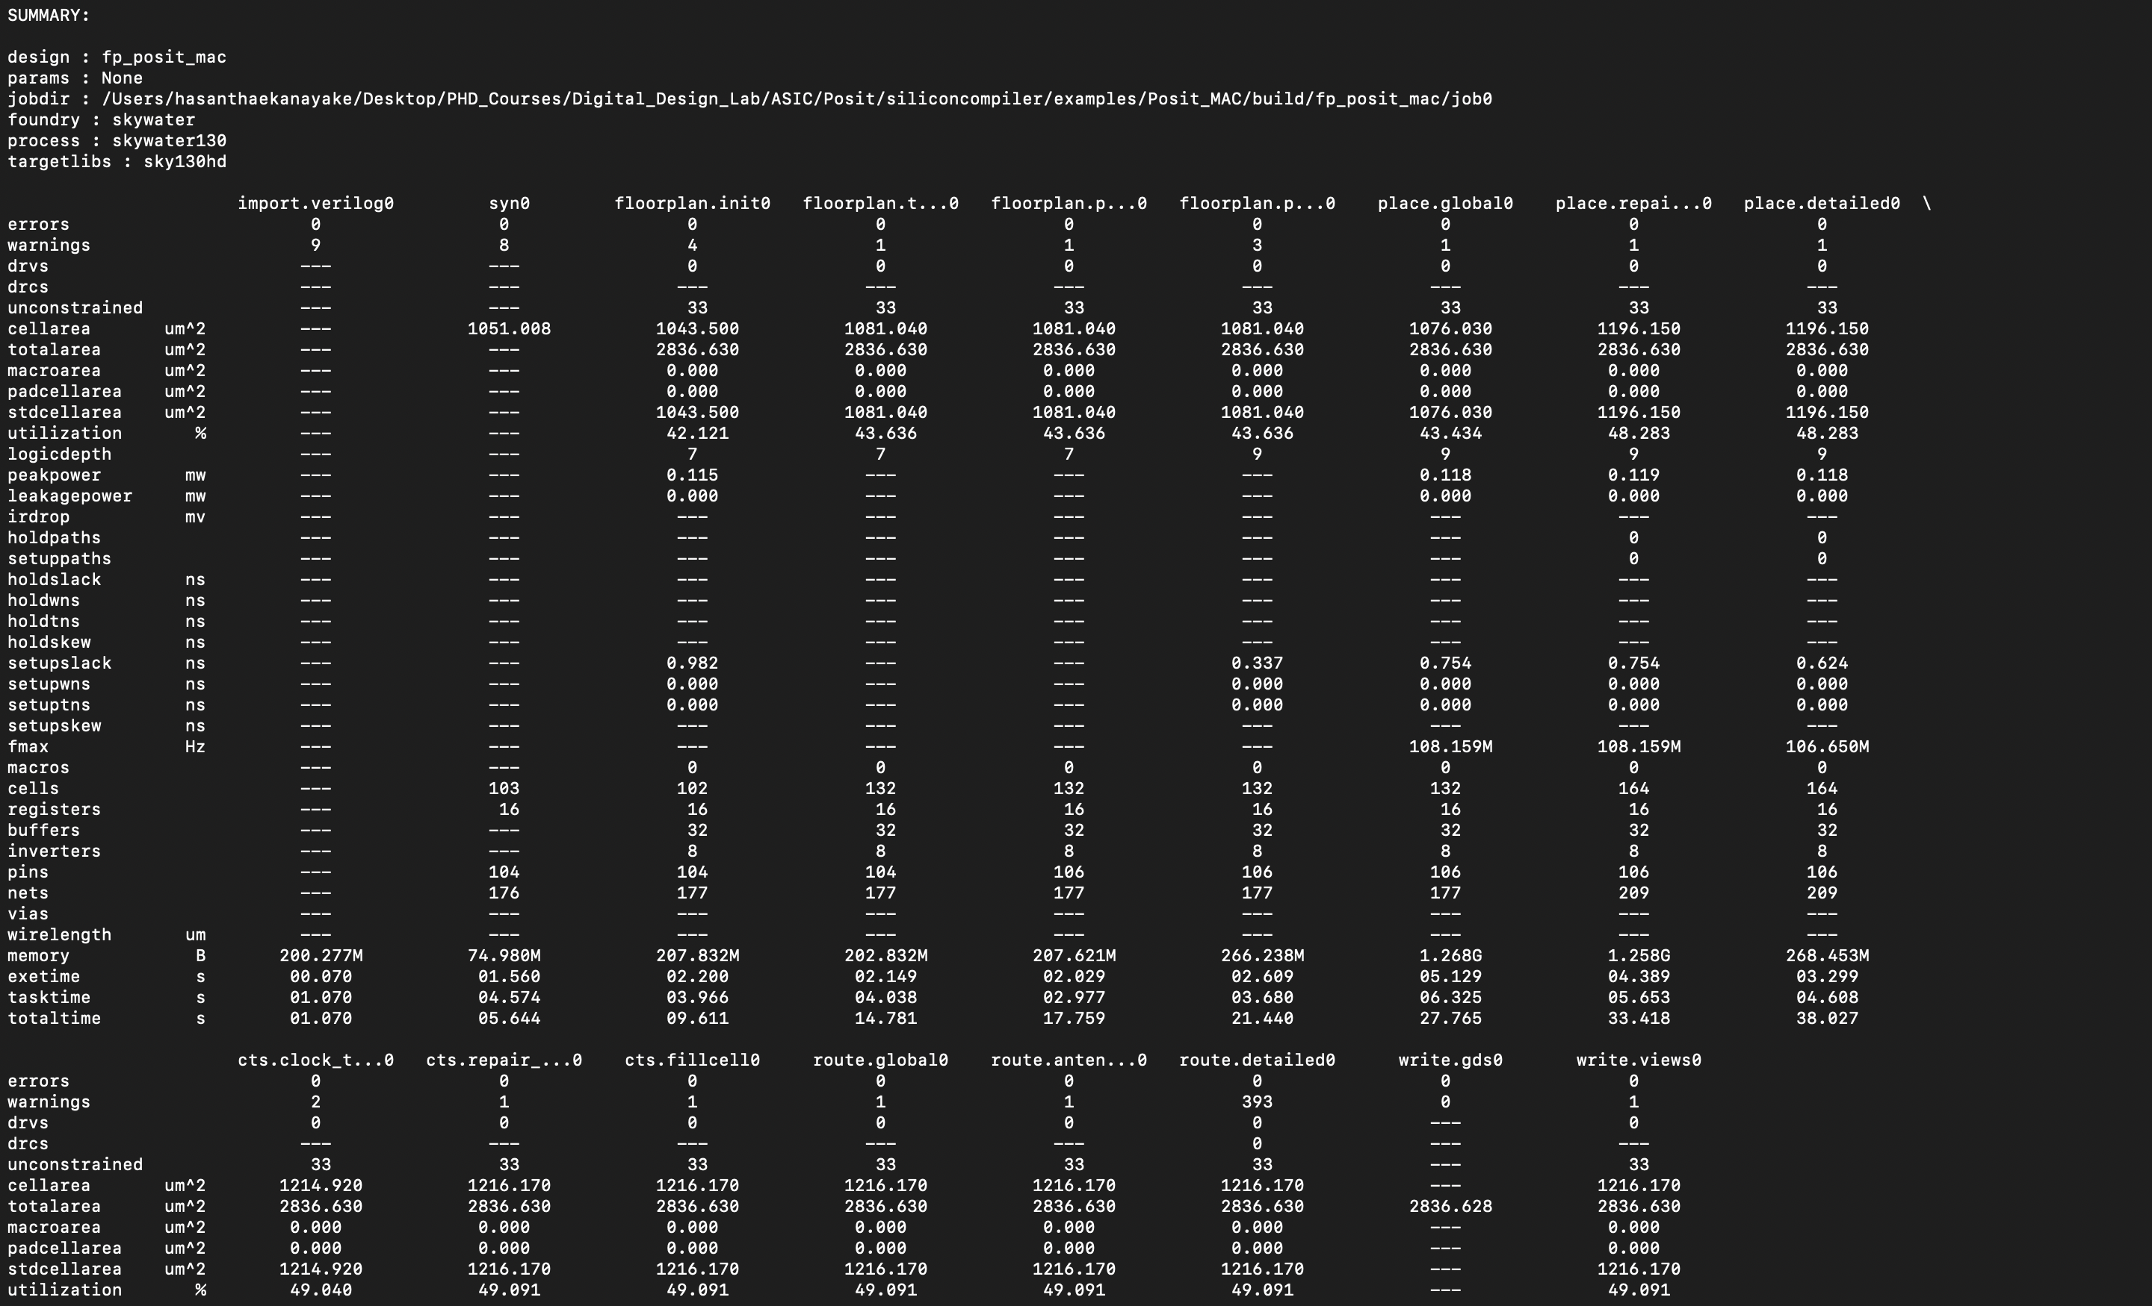
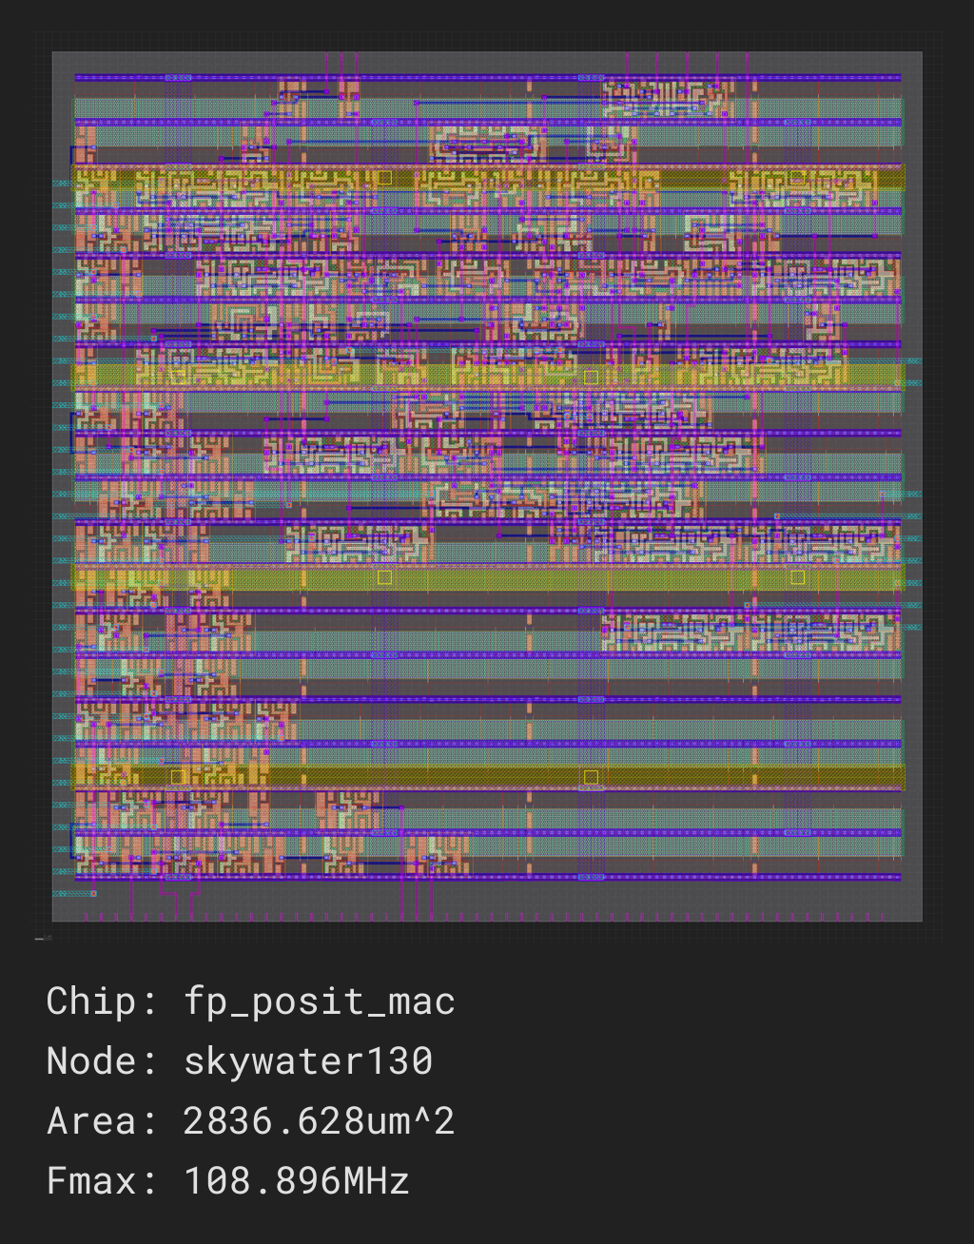
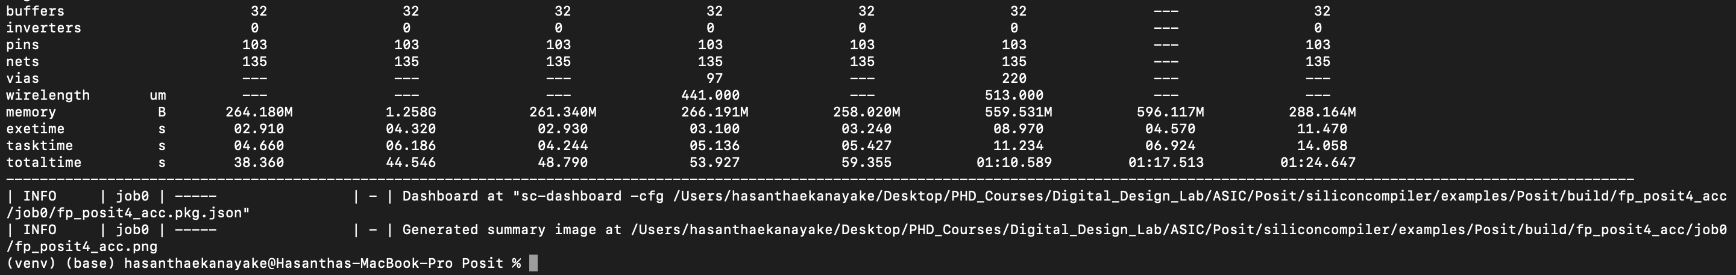
FP16-POSIT4 MAC
2D Layout of the Design

Slide 23
Key Takeaways
FP16 × Posit4 IP was implemented using Verilog and validated through testbench on the PYNQ-Z1 FPGA board via Vitis.
Posit arithmetic enabled memory and logic efficiency, outperforming FP16-Int4 designs in resource utilization.
SiliconCompiler streamlined ASIC backend flow by:
Automating RTL-to-GDS flow from Verilog source
Providing full-chip layout, timing, and power analysis
Demonstrating how open-source tooling can bridge design to silicon rapidly and modularly
We showed that Posit arithmetic can be efficiently deployed in both FPGA-based prototypes and ASIC- design flows.

Slide 24
References
Gustafson, J. (2017). Posit: A potential replacement for IEEE-754. Retrieved from https://www.sigarch.org/posit-a-potential-replacement-for-ieee-754/
Gao, Y. (2023). FP-INT-MAC: A Baseline Integer MAC Core with FP16 Activations. GitHub repository: https://github.com/YiminGao0113/FP-INT-MAC
SiliconCompiler: An Open-Source Framework for Chip Design. Retrieved from https://www.siliconcompiler.com/

Slide 25
Thank you!

